Slide 1
MSSOA WEBINAR NOVEMBER 4, 2020 LEGAL REVIEW
G. Stanton Masters
The Masters Law Firm, P.C.
Not legal advice; for educational purpose only; consult your attorney.

Slide 2
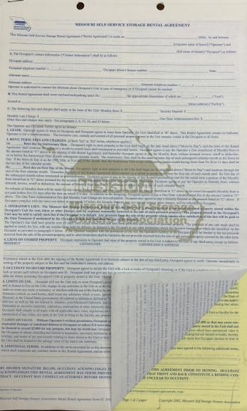

Slide 3
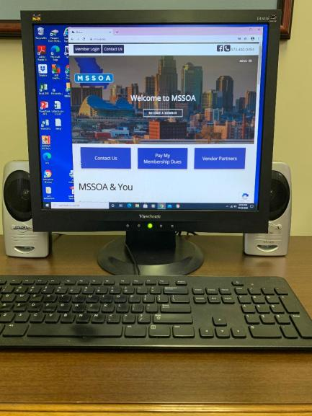

Slide 4
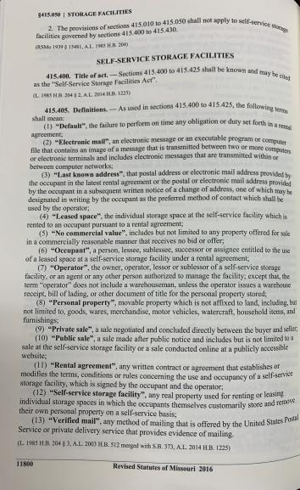

Slide 5
Be Advised: Any sample forms or contracts provided by [Software] are examples only. Please check with your attorney or your state self-storage association as to the legal and proper content of any forms or contracts you use with your business operations. We disclaim any representation or warranty as to the legal or factual accuracy of these sample forms and contracts.
This Photo by Unknown Author is licensed under CC BY-SA-NC

Slide 6
In Plain English:
There’s no guarantee this software complies with Missouri law.
If you use this software without making sure it complies with Missouri law, you alone are responsible for the consequences.

Slide 7
ONLY YOU
CAN COMPLY WITH MISSOURI LAW

Slide 8
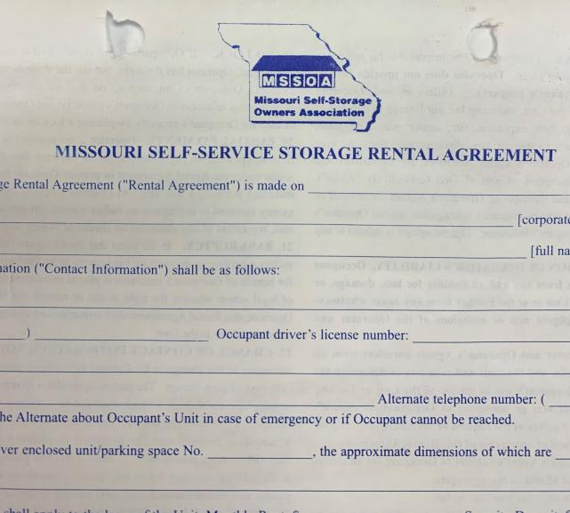

Slide 9
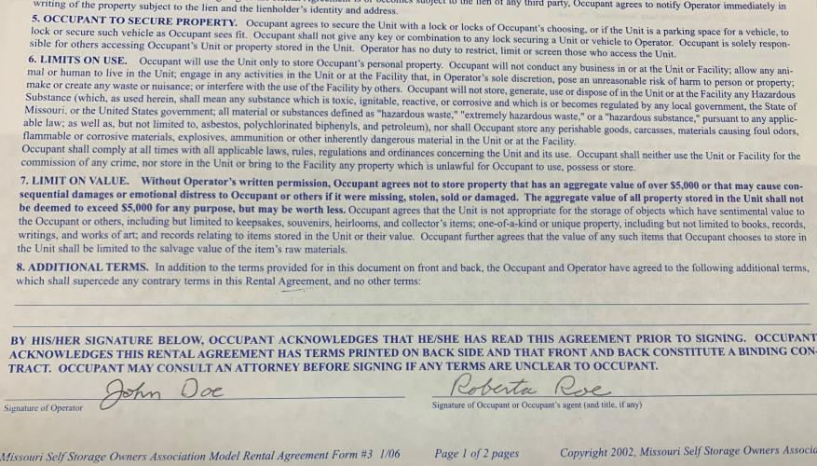

Slide 10
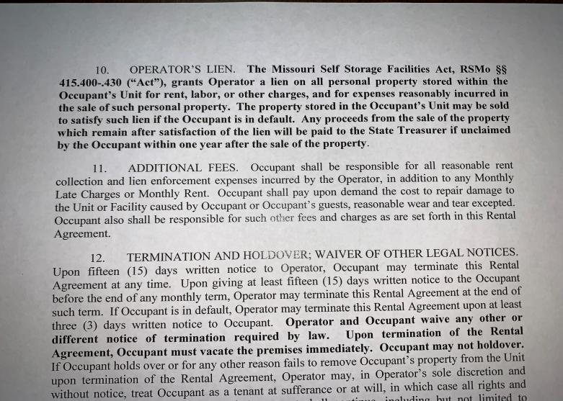

Slide 11
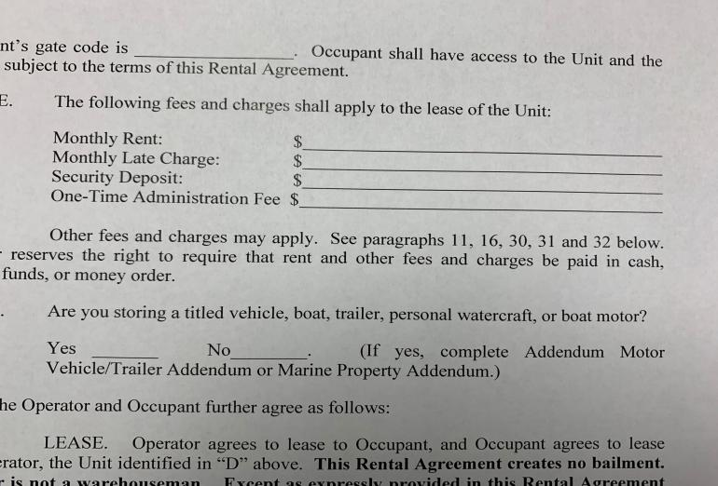

Slide 12
DEFAULT = LIEN SALE
Specific process
Must be followed

Slide 13
1. Default
(as soon as possible send. . .)
2. First Default Letter
(wait more than 10 days and send . . . )
3. Second Default Letter
(be careful – this one’s tricky)
4. Advertisement
(publish once, at least 7 days before #5)
5. Lien Sale
(must be at least 45 days after #2)

Slide 14
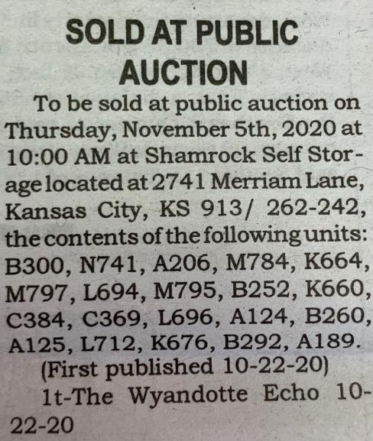

Slide 15
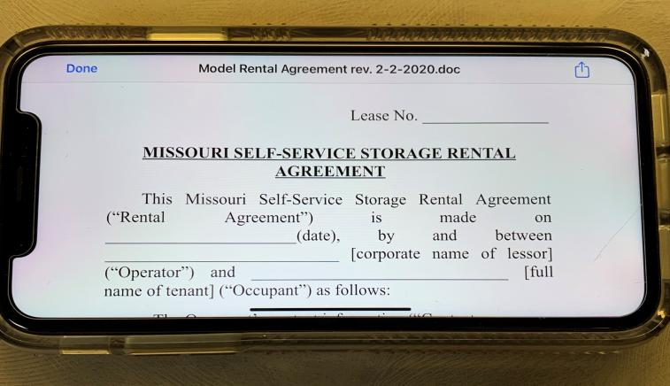

Slide 16
Electronic Contracts/Signatures
Valid and enforceable
There are some potential pitfalls
Missouri Self-Storage law still applies

Slide 19
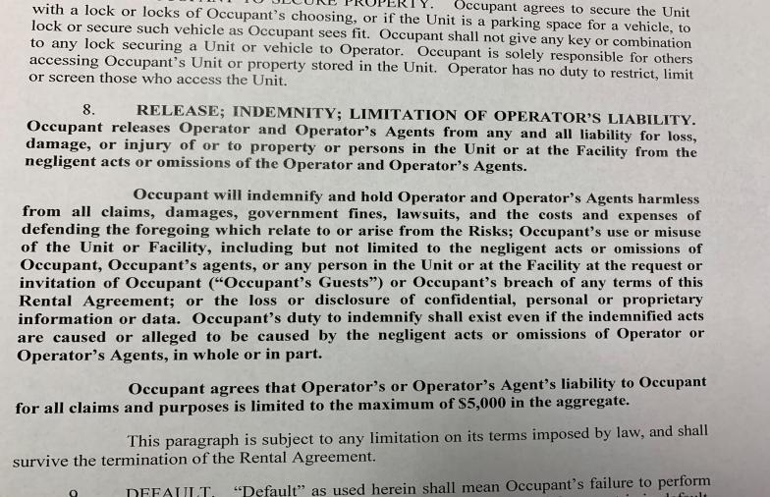

Slide 20
