Slide 1
Disaster Response at Your Facility: Are you Prepared?
Ben Evans
April, 2021
JanusIntl.com

Slide 2
OUR PRESENTER
Ben Evans is the Central Region Sales Representative for Janus International. He has been in the self storage industry for over 14 years, where he started on the commercial side of the business. Ben is a member of the Louisiana Self Storage Association Board of Directors since 2015 and has been part of the Janus International team since 2018.

Slide 3
Are You Prepared?
Natural Disasters
Criminal Activity
Media Response

Slide 4
Emergency Preparedness Manual
Available for order at: www.selfstorage.org
Check with MSSOA for current discounts

Slide 5
Safety First
Notes:
Managers wear many hats, but they are not emergency responders

Slide 6
Natural Disasters
Fire
Tornado
Flood

Slide 7
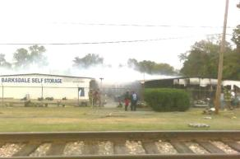
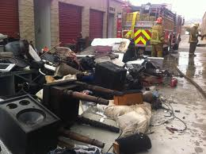
Fire Response
Quickly assess
Call 911
Vacate if fire is present
Use extinguisher on small fires
Unlock all gates/entries for quick emergency access
Evacuate tenants from property
Order a 40 yard dumpster
Call affected tenants to assess property when safe to do so

Slide 8
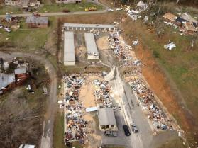
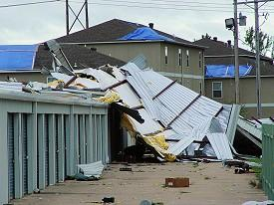
Tornado Response
Tornadoes

Slide 9
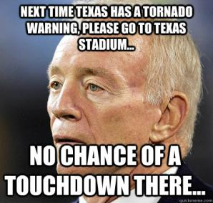
Tornado Response
If under a tornado warning, get into smaller, interior room- closet, restroom, storeroom, etc. DO NOT GO INTO A STORAGE UNIT!
If no safe room available, look for a ditch or culvert and cover yourself

Slide 10
After Storm Passes
Assess damage
In case of fire or downed powerlines, call 911
Unlock all gates/entries for quick emergency access
Call owner and other managers for assistance when safe
Evacuate tenants from property
If emergency work/safety risks are present, all staff should devote attention to keeping customers off property

Slide 11
After Storm Passes
Order 40 yard dumpster
Call affected tenants to assess property when safe to do so
Document correspondence attempts
Refer to insurance requirements in lease agreement
Direct them to appropriate contacts for TI provider

Slide 12
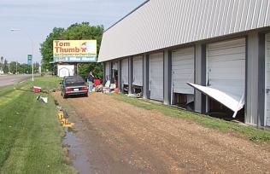
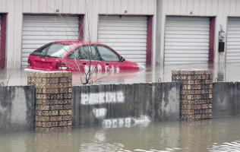
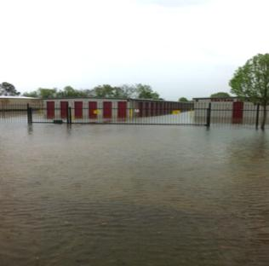
Flood Response

Slide 13
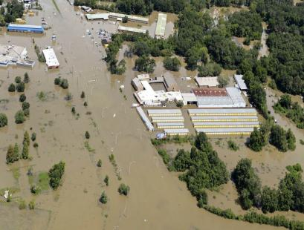
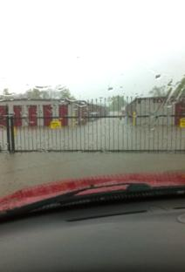
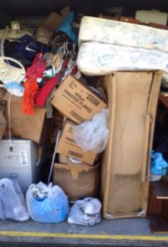
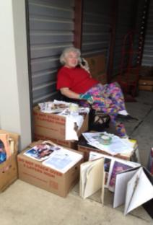
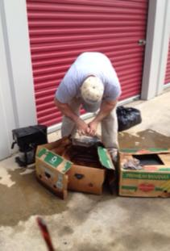
2016 Baton Rouge, LA
24” of rain in just 2 days

Slide 14
Flood Response
Get to an elevated area
Order a 40 yard dumpster
When safe, assess the property
Call affected tenants to assess property when safe to do so
Document all correspondence attempts
Refer to insurance requirements in lease agreement
Direct them to appropriate contacts for TI provider

Slide 15
Flood Response
Take pictures for insurance purposes
Normal insurance covers water coming down, but not rising water
In Baton Rouge, the insurance would cover leaking roofs and water blown in around the doors, but not the ground-up flooding. Only flood insurance from the federal government covers flooding.
If standing water remains in buildings, call your local fire department (NOT 911) to inquire about getting a pump at your facility to evacuate the water. Depending on their workload, they will often do this at no charge.

Slide 16
Free Rent to Local Disaster Victims
“Remember, I am neither a bear not a bull. I am an agnostic opportunist. I want to make money short and long term. I want to find good situations and exploit them.” – TV’s Mad Money host James Cramer

Slide 17
Criminal Activity
Riots
Theft
Drugs

Slide 18
Civil Unrest/ Riots
If riots put your property at risk, lock down gates and entry points
Get into interior room
Call police
Call owner/ DM and let them know what is happening
When safe, assess the property
Take pictures of damage for insurance
Work quickly to secure the property
Repair lights, gates, fences, etc. as needed

Slide 19
Theft
If you suspect units have been burglarized- cut locks, etc.
Notify “potentially” affected customers
DO NOT raise alarm; DO remain calm
How you approach the tenant sets the tone for their experience
DO NOT SAY, “Someone broke into/robbed your unit.”
DO ASK QUESTIONS: When was the last time you were on the property? Did you lock your unit?”
Encourage the customer to inspect their unit
Have the tenant take pictures and report any missing items

Slide 20
Theft
Police reports
Facilities can only file reports on damage to or theft of facility owned property
Each customer must file a report for their own unit/ property
Walk affected customers through the process to file
Tenant police reports may be tied to any facility reports that are filed. This keeps the same detective on each incident.

Slide 21
Theft
Review insurance responsibilities with the tenant
Refer them to the tenant insurance they purchased at move-in.
Document all correspondence attempts

Slide 22
Drugs
Be aware of suspicious activity
Customers who only access at night or after office hours
Review cameras and access activity
Customers asking in-depth questions about security
Greet tenants on property
Daily walk-thru/ lock check
Be aware of what is in your dumpster
Tires, chemicals, plastic bottles that have been cut or medicine blister packs

Slide 23
Drugs
If you suspect illegal activity in a unit
Call police department - Not 911 unless emergency
DO NOT ENTER without a witness, preferably law enforcement, and a camera

Slide 24
Drugs
Include a provision in your lease that allows
Access to files by police
Owner/staff access in the event of a maintenance issue or hazard
Obtain a copy of search warrants for your files
Do not allow police access without a warrant or tenant present
DO NOT TOUCH!

Slide 25
Tenant Communication
Never say, “I’m sorry”- can be twisted into admission of guilt
Instead, acknowledge the tenant’s frustration. “ I understand you are upset; this is an unfortunate situation.”
Refer to insurance requirements in lease agreement
Direct them to appropriate contacts for TI provider

Slide 26
Tenant Communication

Slide 27
Media Response
“When an emergency occurs at your facility and the media contacts you, you may only have a brief opportunity to tell your story- an opportunity that may be filled with emotion confusion and microphones thrust in your face by aggressive journalists.”
“The best you can hope for is fair, unbiased and accurate reporting when the media does a story on you and/or your facility. Your goal should be to convey your message concisely and effectively during interviews in order to maximize your chances of fair coverage.”
Credit: SSA Crisis Communication Guide

Slide 28
Media Prep
Designate a media spokesperson and have a backup
Develop presentation skills
Be informed!
Notes:
DESIGNATE A MEDIA SPOKESPERSON – Owner, district manager, facility manager where the incident occurred. They MUST be knowledgeable of the facility and self storage in general, accessible to the media, calm and comfortable, and finally, ARTICULATE, with the ability to convey a concise message, and stay on message.
DESIGNATE A BACKUP SPOKESPERSON – Be prepared in case primary is not available.
DEVELOP PRESENTATION SKILLS – Watch other TV interviews and anticipate questions that might be asked. Practice with video camera to record mock interviews
MAKE SURE YOUR SPOKESPERSONS ARE INFORMED– Know what you are authorized to say, give consistent message, know names of all involved, and who your legal counsel is and have their number handy if interview goes into precarious legal areas.

Slide 29
Media Prep
Anticipate events that attract media
Public perception is reality
Time is of the essence
Notes:
ANTICIPATE EVENTS THAT COULD ATTRACT THE MEDIA– hurricane or tornado damage, fire or explosions, hazardous materials found in a unit, drug bust at facility, items stolen from a unit, customer complaints to media troubleshooter, a body is found in a unit. Have a response developed for each and write them down.
PUBLIC PERCEPTION IS REALITY – When it comes to media attention and the public perception of your business, you never get a second chance to make a good first impression.
INTIAL RESPONSE CONSIDERATIONS – how a company responds in the first 24 hours largely dictates success or failure in overcoming the emergency. The longer you wait, the perception becomes you have something to hide.

Slide 30
Craft an Effective Message
Think like a journalist
Know the who, when, where, why and how
Write out your basic message
Stay on target with what you want to convey to the media and your tenants about your company
Keep the message clear and concise
A 25 minute interview will be reduced to a 25 second news spot or a 7-15 second sound bite
Focus on 2-3 key points and practice communicating in 7-15 second chunks of information
Notes:
THINK LIKE A JOURNALIST– know the who, when, where, why and how.
CRAFTING AN EFFECTIVE MESSAGE– Top priority - gather the facts surrounding the event in question and develop a concise, effective message. Speak not just to the media in an interview, but to your customers, AND FUTURE CUSTOMERS, as well. Tell them what you are doing to handle the situation.
WRITE OUT YOUR BASIC MESSAGE- keeps you on target with what you want to convey to the media and your tenants about your company.
KEEP THE MESSAGE CLEAR AND CONCISE

Slide 31
Craft an Effective Message
Keep the message positive
Assure your customers (and potential customers!) that your facility is still safe if a crime occurred, emphasize your safety record, security measures and customer screening at move-in.
Express empathy and have a caring attitude
Do not admit guilt, apologize or say you are sorry
You are “actively looking at what happened and will take corrective measures”.
Have a brief background sheet about your company ready

Slide 32
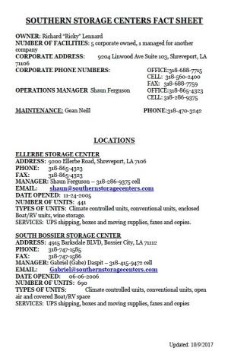
The Red Envelope
Develop a prepared background sheet for your facility and make sure it is in a known location in the office
Include name and contact information for:
The Owner
The District Manager
The Facility
Also include: # of units, date opened, services offered (box sales, truck rentals, UPS shipping, etc.) and the types of units (climate controlled or conventional)

Slide 33
Express the Effective Message
Take charge of the interview.
Find out who is interviewing you and who they represent.
NEVER LIE – THEY WILL FIND OUT!!!
Answer all questions as fully and candidly as you can.
AVOID SAYING “NO COMMENT” – it looks like you are hiding something.

Slide 34
Express the Effective Message
Try to explain if there are legal reasons you can not give an answer.
Educate about your industry.
Use facts to counteract rumors.
NEVER volunteer negative info!
DON’T BE DEFENSIVE or ANGRY!

Slide 35
Express the Effective Message
NEVER repeat a negative or accusatory statement
Avoid “Yes” or “No” answers
If you digress, get back on track. Quickly!
Don’t be afraid to say “I don’t know at this point.” Then find out.
Don’t offer speculations or opinions. Can get messy!

Slide 36
Express the Effective Message
STICK TO THE FACTS! Don’t give sensational or overdramatic recounts – facts can get changed.
If goofing it up, ask to start over.
Don’t argue with reporter.
“Off the record” does not exist!

Slide 37
Evacuee Makes Latest Complaint May 7, 2006
New Orleans evacuee Peter Thomas came back to Shreveport to take the remaining items from his storage facility back to the Crescent City--when he got a big surprise. "I put my hand on the first item and it was soaking wet. It was a mattress," he says. Thomas had stored his furniture at ******* ***** Storage on Jewella. Inside the facility, he says, was the little bit his family had accumulated since losing everything during Hurricane Katrina. "We have no words for it. We just--its more of the same. More bad luck," he says. Like many ******* ***** customers, Thomas had signed an agreement to "not hold" the company responsible for damages to his property. "I paid for a facility that was climate controlled because I had some furniture," reflects Thomas. He calls the flooded conditions a major breach of his expectations of the facility. Thomas even documented what he saw with his handheld video camera. ******* *****'s district manager Brandon H***** spoke with News 12 by phone. He told us, "We've had a couple of leaks here and there. Since then we've been putting a new roof on there. I don't understand where the leaks came from." Howes says the roof should be finished in a week. They told some other customers the same back in March.
Thomas says all that's too late for him. "The only good thing they told me is that I can use their dumpster to throw my stuff away."

Slide 38
Contact Our Presenter
Ben Evans
Central Region Sales Representative
Janus International
Ben.Evans@JanusIntl.com
903.601.0266

